Slide 1
Milestone 1
Group 13
Yannick Gachnang, Lu Men, Calvin Lieu, Harry Guan
Notes:
Hey guys, we are skyfall webgpu

Slide 2
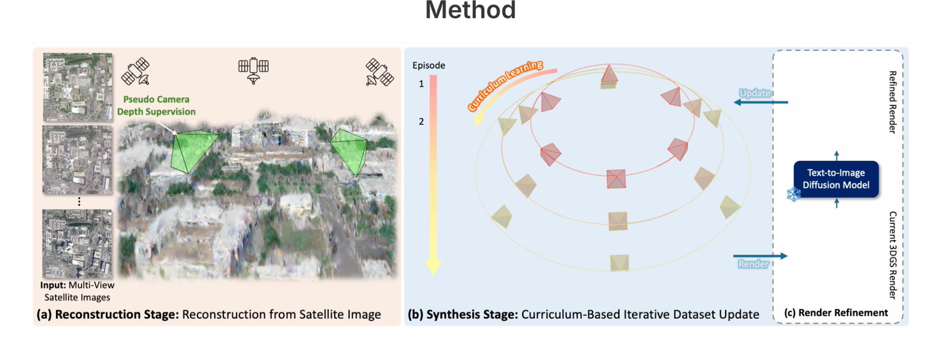
Skyfall GS Webgpu
Notes:
For this project, we wanted to bring the Skyfall-GS pipeline into the browser using WebGPU. The idea is to take multi-view satellite images, reconstruct a 3D scene using Gaussian Splatting, and then render it in real time on the web. Essentially, we’re building a small Google-Earth-style viewer that runs entirely in the browser.

Slide 3
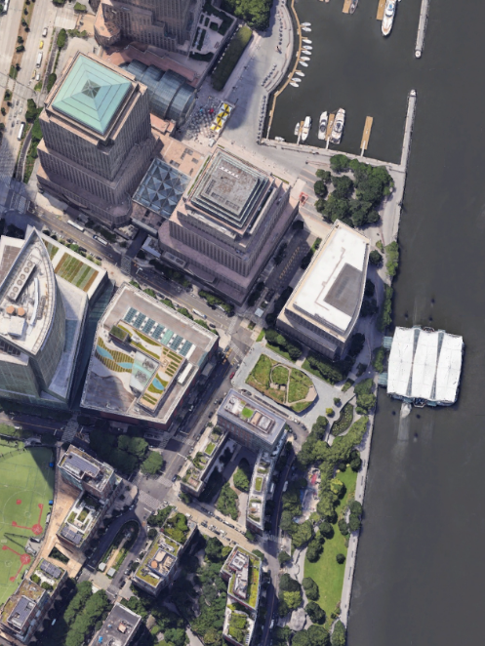
Data Loading and Rendering
Data
  3D point cloud
  a set of 2D satellite images + corresponding cameras
Render the 3D points into a camera’s view
Notes:
As part of milestone 1, we implemented modules to load and store data. Our program takes in two kinds of data: first, an initial 3D point cloud, and second, a set of satellite images with their corresponding camera settings. We have also implemented a render that renders the current point cloud into a camera’s view. These are the backbone when we move into the next step, which is optimizing the gaussians.

Slide 4
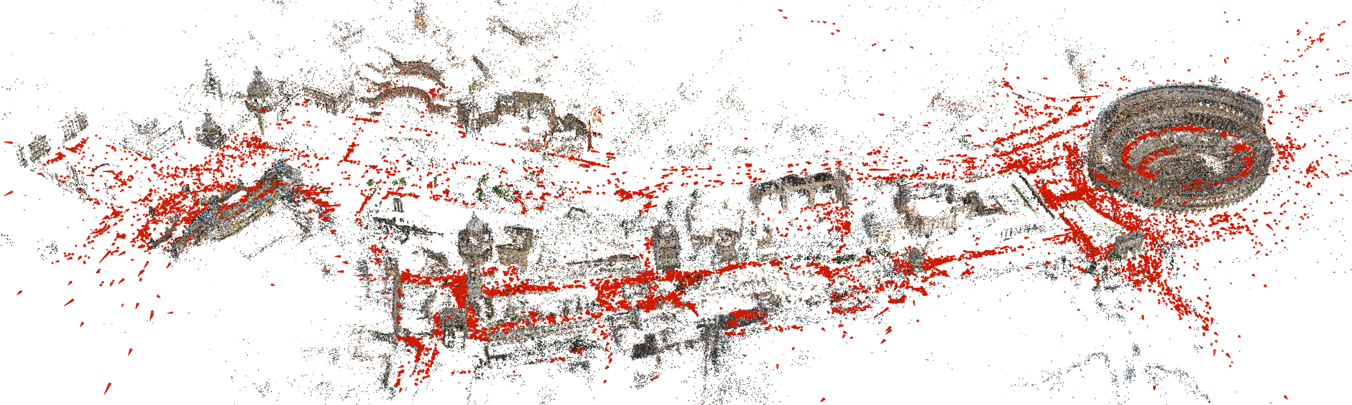
Gaussian Splat construction
Convert 3D points into Gaussian primitives
Densify and prune to refine splat distribution
Tuned training parameters for faster convergence
Generated checkpoint models for later refinement
Notes:
For this stage, we focused on constructing the Gaussian splats that represent the scene. So we take the 3d point cloud convert each of these points into Gaussian primitives — so we have position, orientation, scale, color, and opacity and together these form a smooth continuous representation of the scene rather than discrete points. The next step was to actually train the model and during this process the splats are optimised using a differentiable renderer that compares rendered views to real images. My GPU wasn't good enough to finish training in a reasonable amount of time with the same parameters as the paper so we had to adjust some like kernel size and gradient thresholds, and we also limited densification to a smaller number of iterations — which just means the model stops adding new splats earlier. As a result, we have a compact, decently-optimized Gaussian model that captures the geometry and appearance of the satellite scene, and this will serve as the foundation for the later IDU refinement stages.

Slide 5
WebGPU renderer adaptation
Added shared GPU buffers for live updates
Integrated preprocess + sort for training compatibility
Implemented Google Maps–style camera
New default camera setup (top-down view)
Notes:
My part focused on adapting the Gaussian renderer to work inside our training pipeline.
I made the renderer fully dynamic — so instead of static buffers, it now supports loading, resizing, and live updates directly on GPU.
I also fixed the preprocessing and sort stages so they run smoothly each frame, and added map-style camera controls for intuitive navigation.
Here’s a short clip showing it running with Skyfall’s sample .ply data.
This will be our visualization backbone for the reconstruction stage in Milestone 2

Slide 6

WebGPU renderer adaptation (demo)

Slide 7
Next Steps (Milestone 2)
Connect renderer to training compute passes
Visualize photometric / opacity loss during optimization
Integrate multi-view camera alignment
Begin non-ML refinement stage (curriculum updates)
Notes:
Next, we’ll hook this renderer directly into the training compute passes so we can visualize the reconstruction live.
We’ll also start displaying loss terms and camera paths, and implement the non-ML iterative refinement from Skyfall-GS.
That’ll take us into the full reconstruction stage for Milestone 2.

